Slide 1

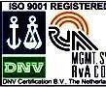
Project Presentation (KCS 753)
(NFT ArtHub - A MARKETPLACE FOR DIGITAL ARTS)
KIET Group of Institutions, Ghaziabad
(An ISO – 9001: 2008 Certified & ‘A+’ Grade accredited Institution by NAAC)
Guide Name: Dr. Harsh Khatter
Project Members Name with Roll Number & Section
1.Aniket Singh -2100290120029(CS-8A)
2.Ankit Kumar Mishra-2100290120030(CS-8A)
3.Annu -21002901200032(CS-8A)
4. Ayush Mishra -2100290120062(CS-8A)

Slide 2
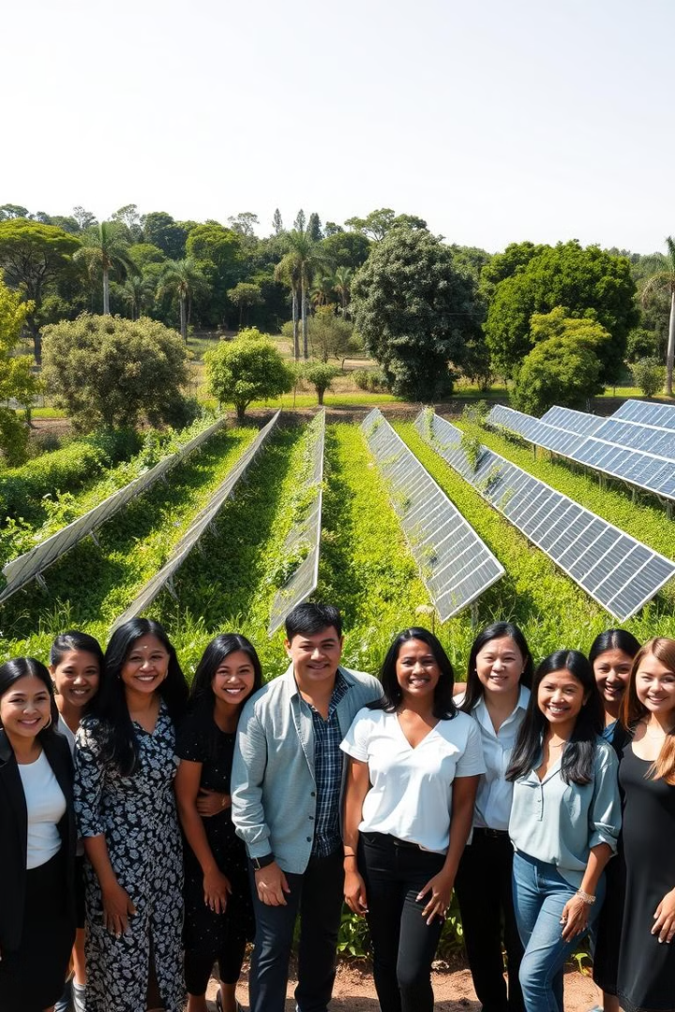
NFT ARTHUB
This project aims to revolutionize the digital art market by providing a unique e-commerce platform that leverages NFTs. By enabling artists to mint, showcase, and sell their digital art as NFTs, the platform ensures authenticity, ownership, and security for both creators and buyers. This innovative approach bridges the gap between art and technology, fostering a community of artists and collectors while transforming the way digital art is valued and traded.

Slide 3
Project Abstract
Overview
Key Objectives
Approach
This project aims to transform digital art through a comprehensive approach, integrating blockchain, NFTs, secure storage, and comownershipmunity engagement. It provides artists with a platform to mint, showcase, and sell their work.
To build an NFT e-commerce platform for digital artists to securely mint, showcase, and sell art, ensuring authenticity and ownership while fostering a creative community.
Integrate blockchain technology, NFTs, Ethereum smart contracts, and Pinata IPFS; develop a secure server infrastructure; and engage with artists and collectors to foster a collaborative digital art marketplace

Slide 4
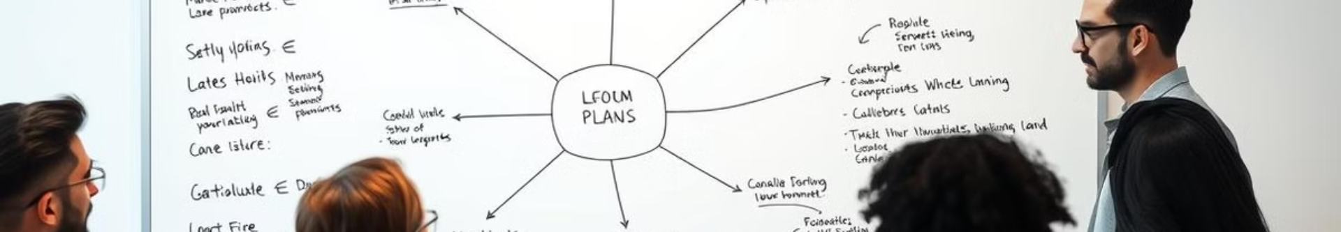
Project Goals and Objectives
Empower Artists
1
Provide a secure platform for digital artists to easily mint, display, and sell their artwork as NFTs, ensuring full control over their creations and revenue.
Ensure Security
2
Leverage blockchain technology to facilitate transparent transactions, guarantee ownership authenticity, and provide secure storage for digital art assets.
Community Building
3
Create a vibrant, interactive space for artists, collectors, and enthusiasts to connect, share, and appreciate digital art, fostering collaboration and growth within the community.

Slide 5
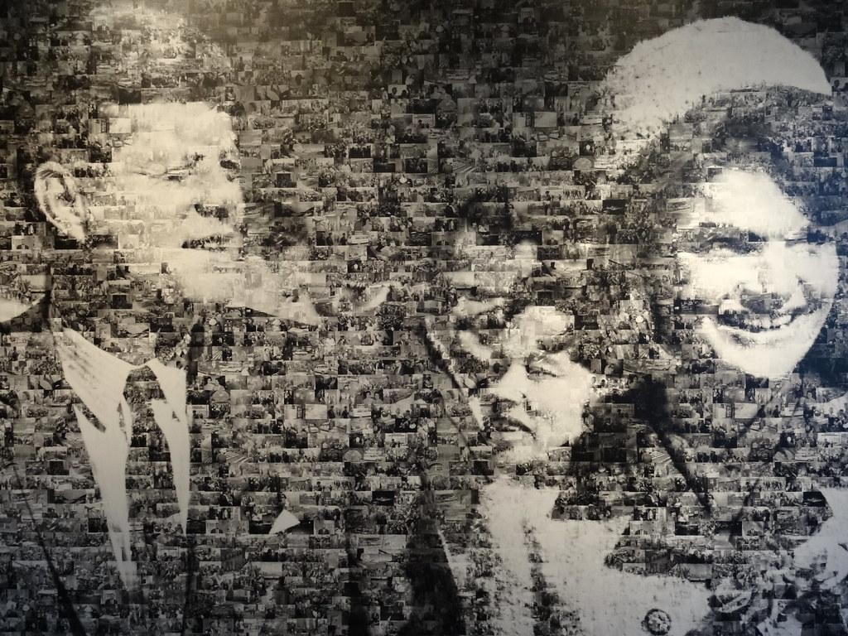


BACKGROUND
"The Digital Art Revolution
Rise of Digital Art:
"Digital art has transcended boundaries, gaining prominence as a vibrant and expressive medium."
Democratization of Creativity:
"Artists worldwide are empowered to create, share, and thrive in a borderless digital landscape."
Transformation of the Art Market:
"Witness the metamorphosis of the traditional art market as it embraces the limitless possibilities offered by the digital realm."
ArtNFT Marketplace’s Impact:
"ArtNFT Marketplace serves as a catalyst, bridging the traditional and digital art worlds, empowering artists to reach a global audience."

Slide 6
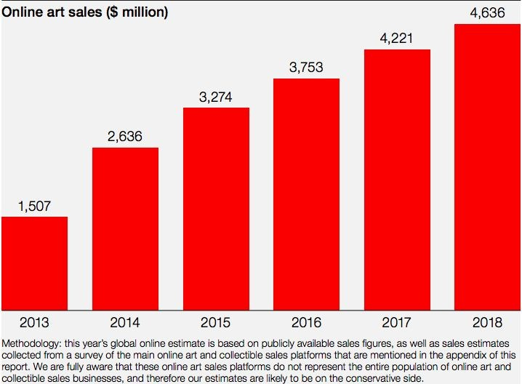
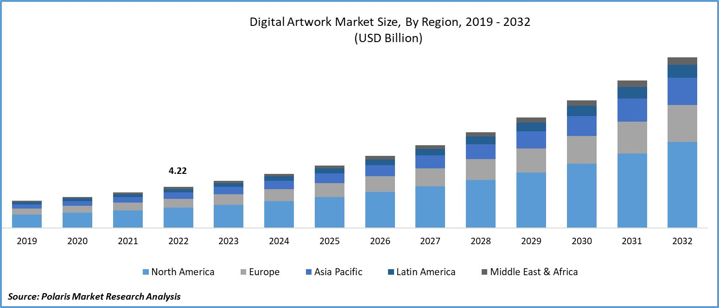
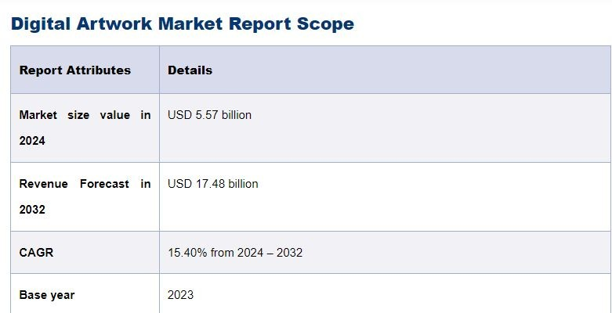

Slide 7
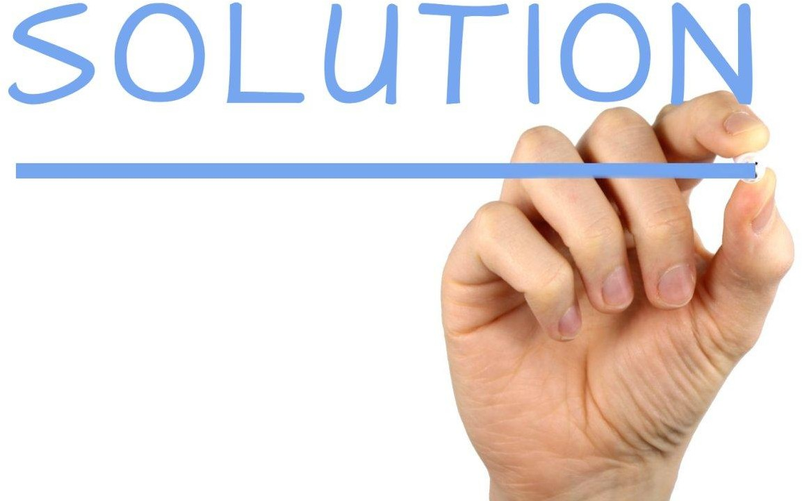
OUR PLATFORM:- NFT ARTHUB
"Empowering Artists, Connecting Collectors, Ensuring
Security"

Slide 8

Flow of work
NFT Creation and Ownership:
Artists upload digital creations, triggering unique NFT creation through smart contracts.
Smart contracts ensure authenticity, provenance, and immutable ownership records.
Blockchain as a Decentralized Ledger:
Blockchain serves as a transparent ledger, recording NFT transactions and ownership changes.
Cryptographically signed transactions provide a tamper-proof audit trail.
Transaction Initiation:
Backend server initiates a secure blockchain transaction for NFT ownership transfer.
Smart contracts execute ownership transfer functions.
Ownership Transfer:
NFT purchases initiate blockchain transactions for secure and transparent ownership transfers.
Smart contracts automatically update ownership records reliably.

Slide 9
Decentralized Storage for Metadata:
Metadata (title, description, image URLs) stored in decentralized solutions linked to the blockchain.
Ensures accessible, veriﬁable, and censorship-resistant metadata, enhancing transparency.
Data Integrity and Security:
Blockchain employs cryptographic hashing and consensus mechanisms for secure NFT data.
Transactions are cryptographically secured, establishing a tamper-proof and trustless art commerce environment.
Royalty Payments and Smart Contracts:
Smart contracts within NFTs include royalty payment mechanisms.
Artists receive fair compensation through automatic enforcement of royalty agreements during resales.

Slide 10
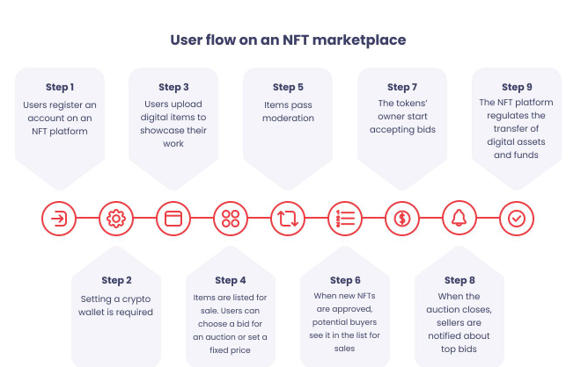

Slide 11
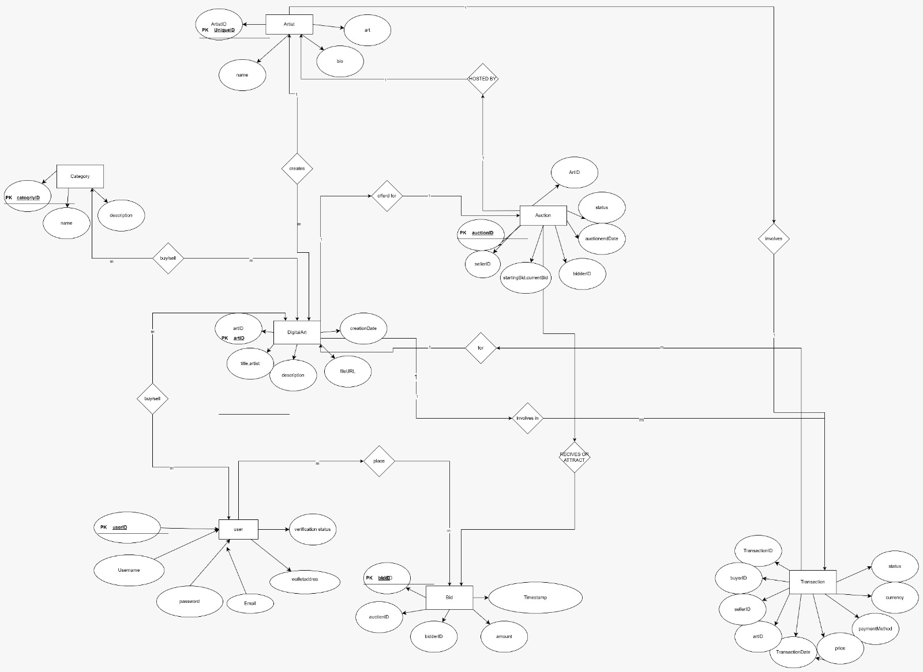

Slide 12
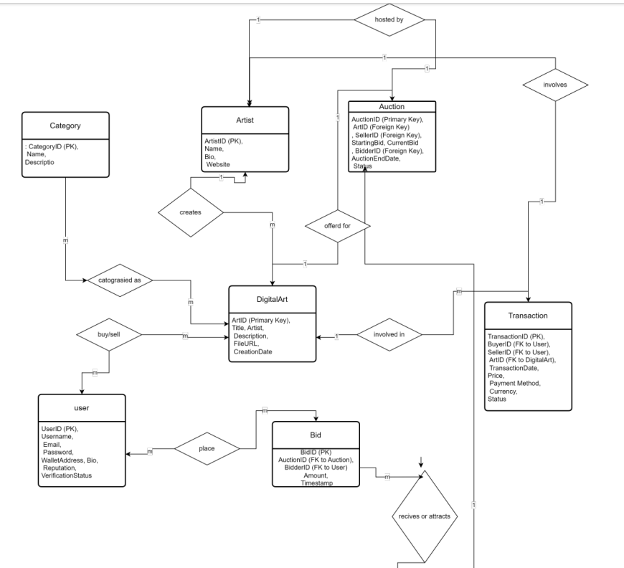

Slide 13
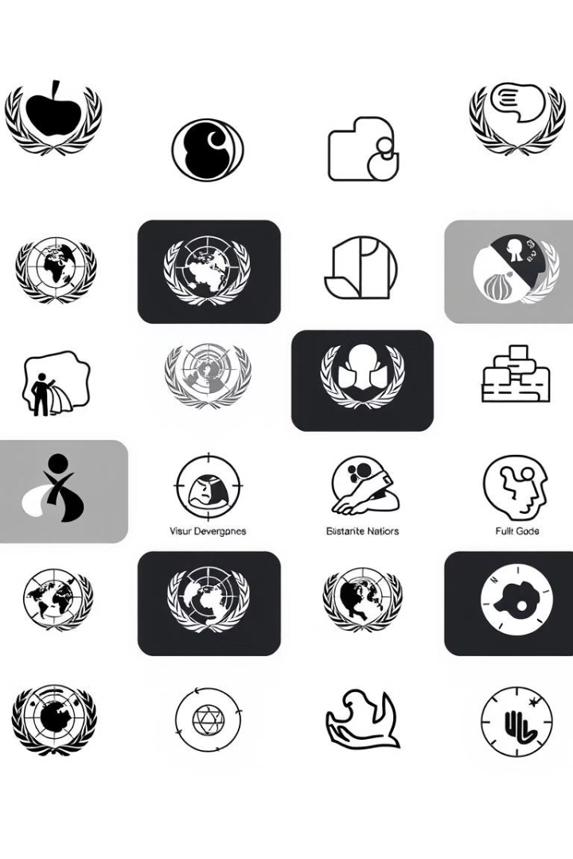
Alignment with UN Sustainable Development Goals (SDGs)
SDG 8: Decent Work and Economic Growth
SDG 9: Industry, Innovation,
and Infrastructure
Creates economic opportunities for digital artists to monetize their work.
Drives innovation with blockchain and NFTs for digital art.
SDG 10: Reduced Inequality
SDG 17: Partnerships for the Goals
Protect, restore, and Provides global access, reducing barriers for artists.
Strengthen global partnerships to support and achieve the SDGs.

Slide 14
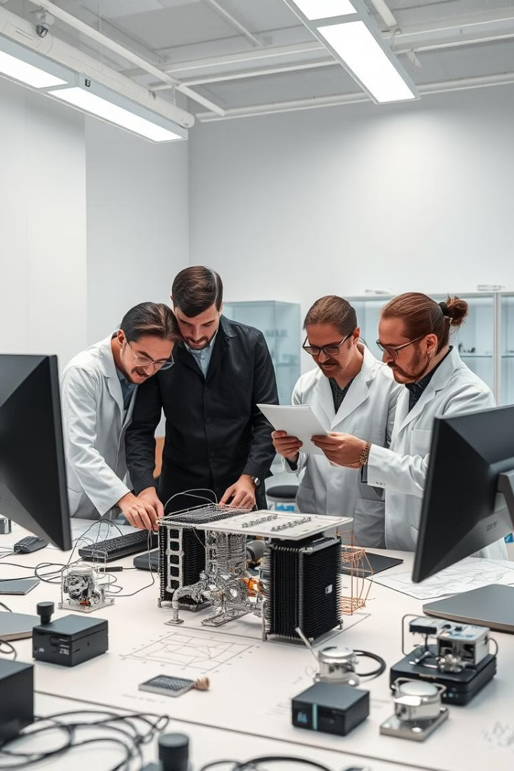

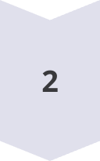
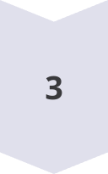

Methodology and Approach
Integrate Blockchain and solidity for smart contract
Use blockchain and Solidity-based smart contracts to enable secure, transparent ownership and transaction processes for digital art NFTs.
Implement NFTs and Decentralized Storage:
Mint NFTs using standardized protocols, with decentralized storage (e.g., Pinata IPFS) to protect digital assets.
Transaction and Security Management
Implement secure payment systems and ensure transparent, blockchain-backed transactions for verifying NFT ownership and protecting user data.
Community Empowerment
Engage with artists and collectors, building a vibrant, inclusive community through interaction tools

Slide 15
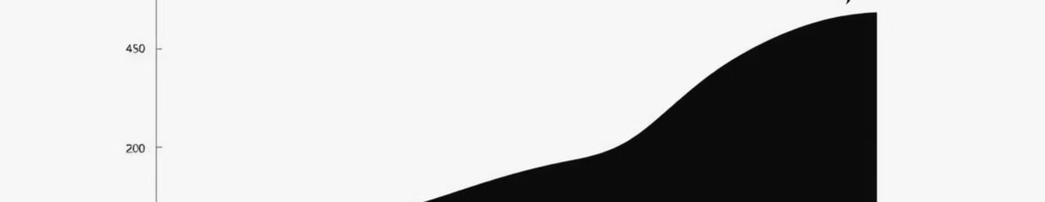
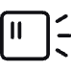
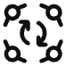
Expected Outcomes and Impact
Empowered Digital Artists
Thriving DigitalArt Community
Community Empowerment
Artists gain a secure, accessible platform to monetize and protect their work, promoting economic growth within the digital art space.
A global network of artists and collectors fosters collaboration and appreciation for digital art.
Tools facilitate active interaction, creating a supportive environment for artists and collectors

Slide 16
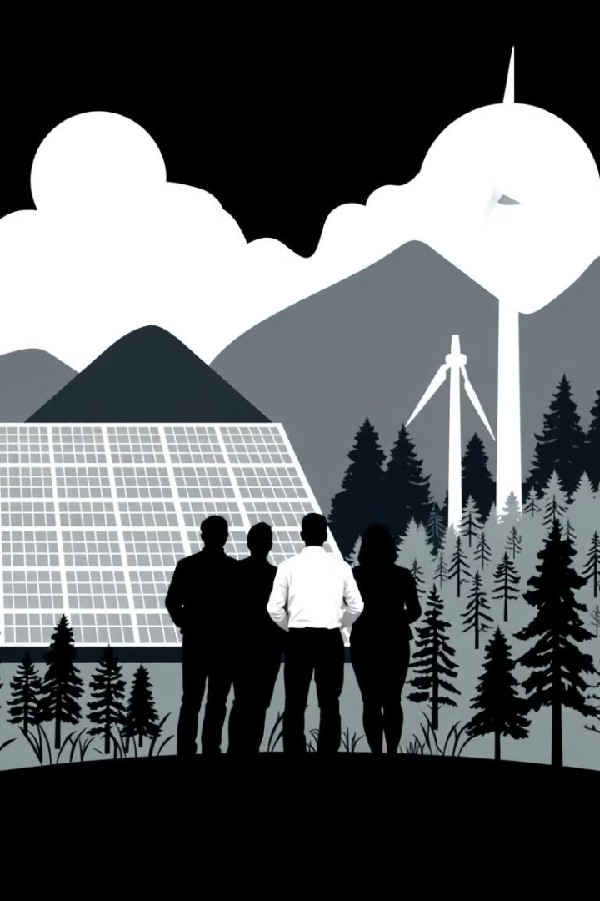
Key Project Deliverables
Design UI/UX, integrate blockchain, deploy smart contracts for transactions.
Platform Development
and Design:
Secure login, integrate MetaMask, and deploy Solidity smart contracts for transactions.
User Authentication and
Wallet Integration
Testing, Deployment, and Support:
Conduct tests, deploy website, provide post-launch bug fixes, scalability.

Slide 17
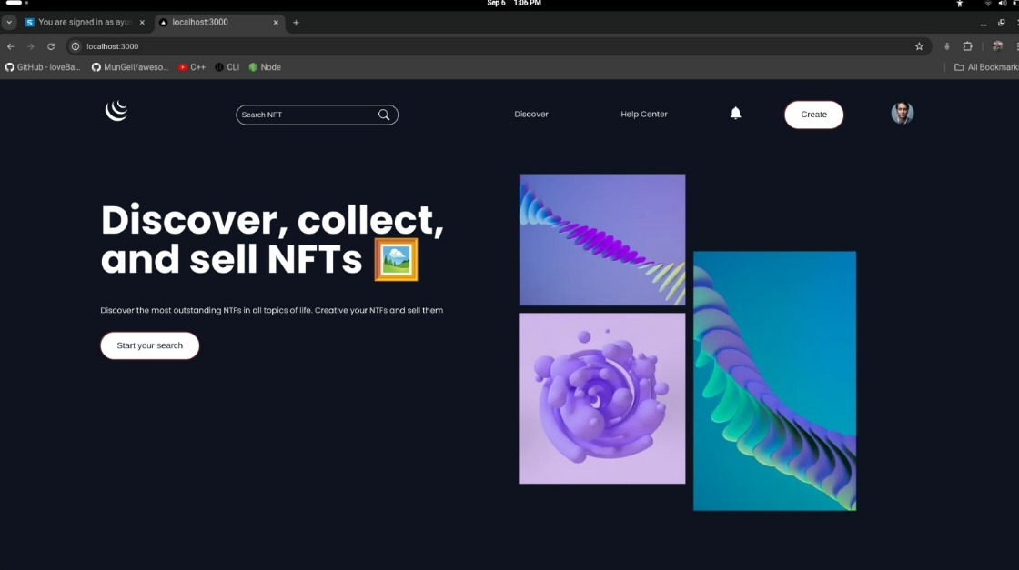
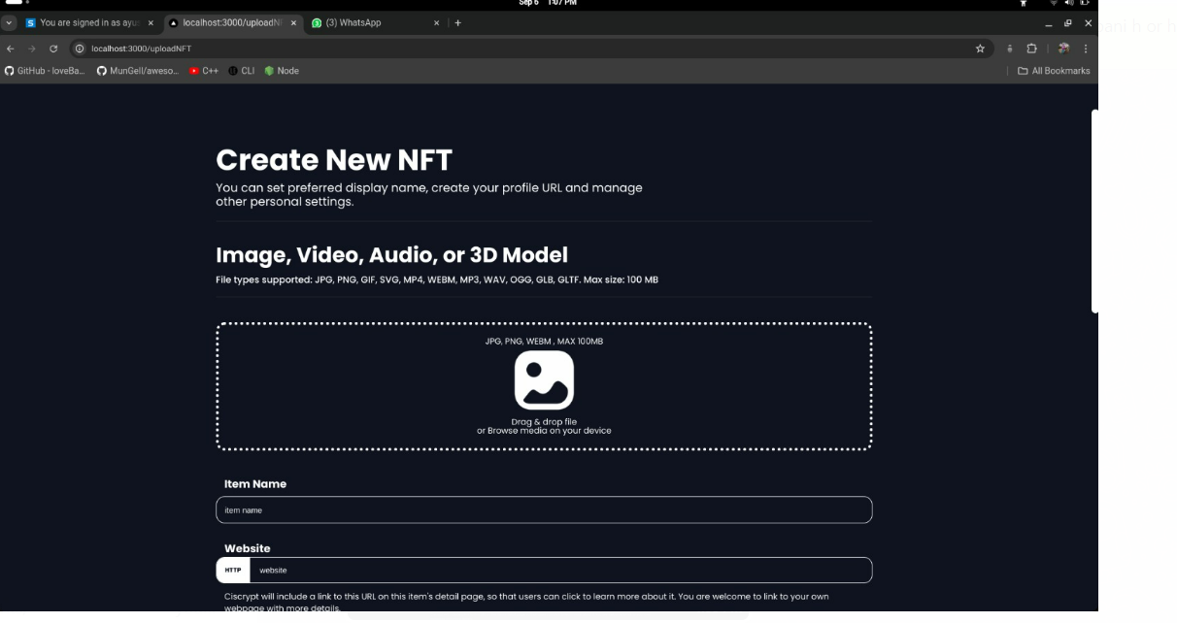
Project Status
HOME PAGE

Slide 18
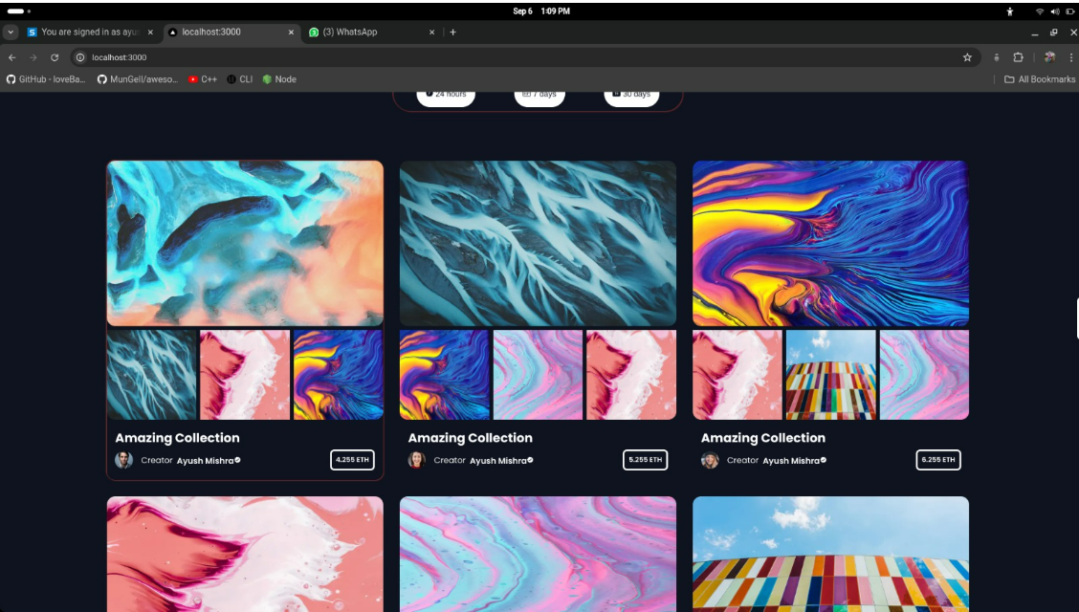
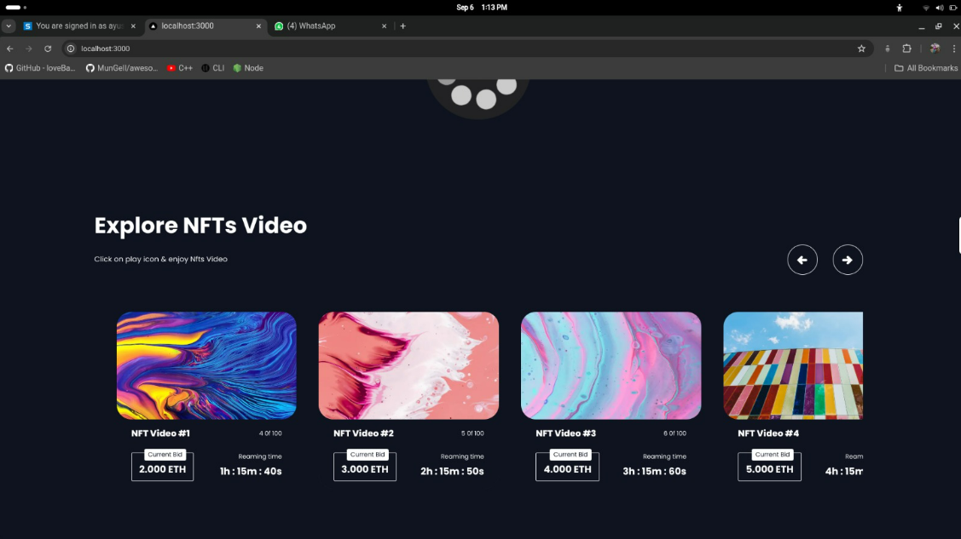
Collection page
.

Slide 19
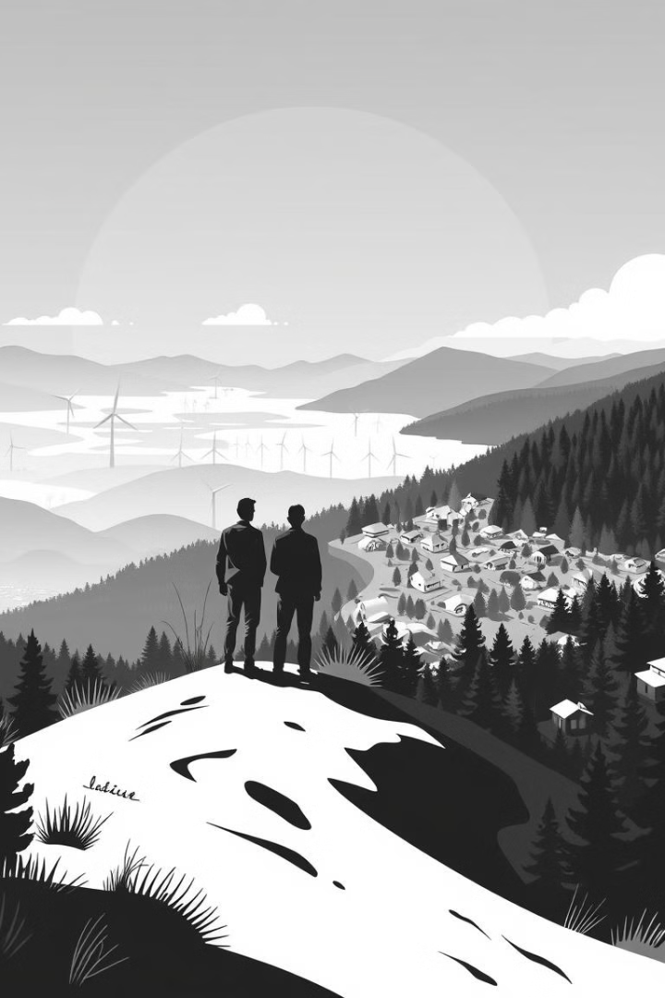
Next Steps and Conclusion
1
Scalability
2
Forge Partnerships
Ensuring the platform can handle growth by optimizing infrastructure for increased users and transactions.
Establish partnerships with digital art communities, influencers, and other platforms to enhance visibility and growth.
3
Conclusion
This project will create a secure, scalable NFT marketplace for digital artists, promoting innovation, trust, and community growth, while ensuring long-term sustainability and adaptability.

